Slide 1


AutoGluon 1.2
NeurIPS Expo Workshop, 10.12.2024
Advancing AutoML with Foundation Models and LLM Agents
Nick Erickson, Senior Applied Scientist, AWS, neerick@amazon.com
Abdul Fatir Ansari, Senior Applied Scientist, AWS, ansarnd@amazon.com
Boran Han, Applied Scientist, AWS, boranhan@amazon.com
Shuai Zhang, Applied Scientist, AWS, shuaizs@amazon.com

Slide 2
Agenda
Agenda | Duration (PT)
Introduction + AutoGluon Tabular | 12:00PM – 12:30PM
AutoGluon Assistant | 12:30PM – 12:45PM
AutoGluon TimeSeries | 12:45PM – 1:10PM
AutoGluon Multimodal + AutoGluon RAG | 1:10PM – 1:25PM
Recap + Q&A | 1:25PM – 1:30PM

Slide 3




Machine Learning can be tricky…
Preprocessing
Model training
Input data
Model selection
Predictions
Cross validation
Ensembling

Slide 4
7 Steps to an AutoML Revolution
Easy
Accurate
Fast
Reliable
Insightful
Customizable
Deployable

Slide 5
AutoGluon makes ML easy
Input data
Predictions

Slide 6
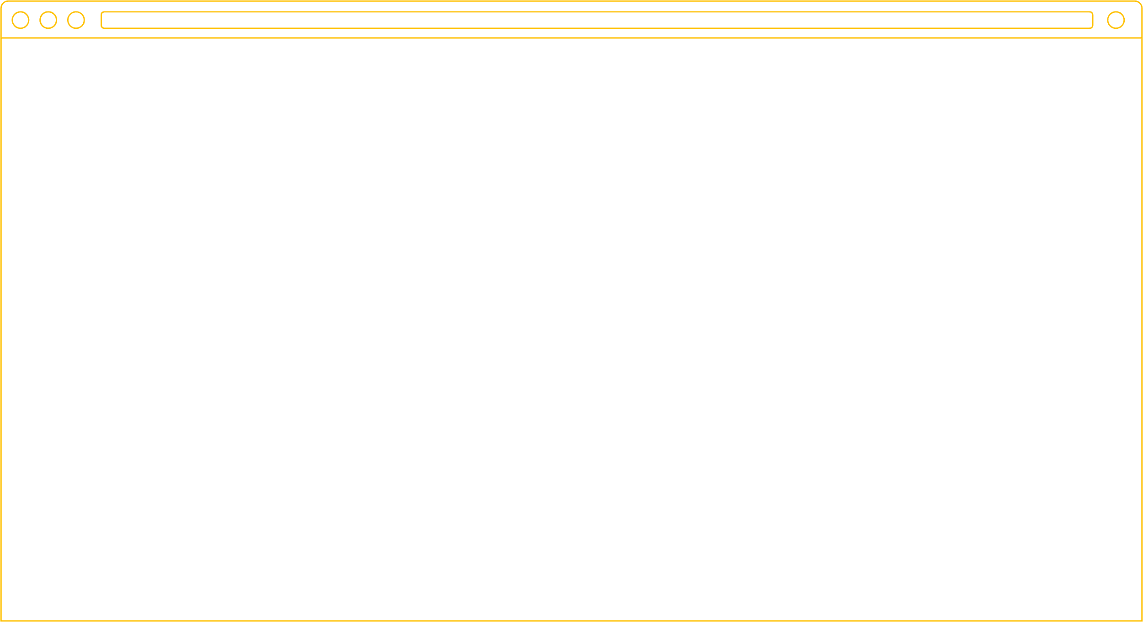
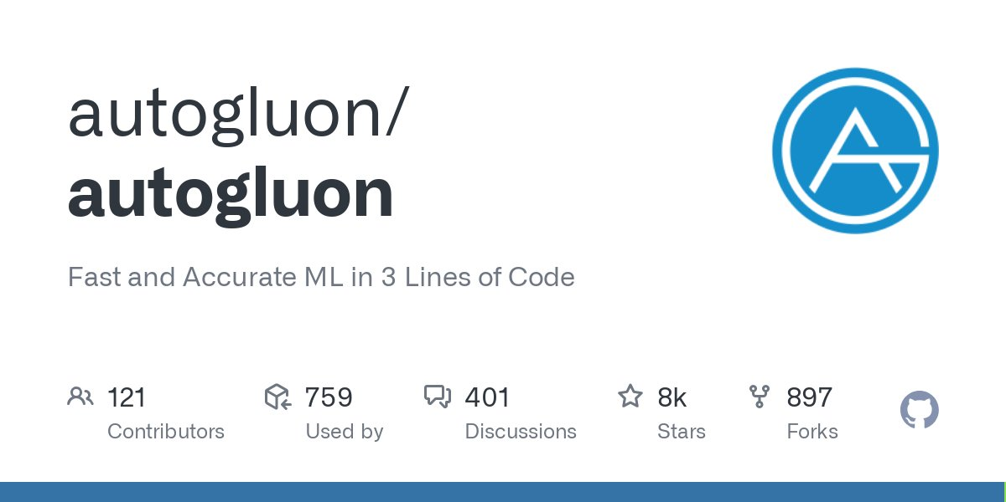




What is AutoGluon?
Open source AutoML toolkit that democratizes machine learning
auto.gluon.ai
Fast & accurate ML in 3 lines of code
pip install autogluon
Supports tabular, time series, image, text, multimodal data

Slide 7



AutoGluon Overview
30,000+
900+
200+
SDEs learn ML with AutoGluon in Amazon’s Machine Learning University
Amazon projects and services deploy AutoGluon
companies use AutoGluon, including NVIDIA, Intel, NFL, Oracle, Mitsubishi, and Capcom

Slide 8
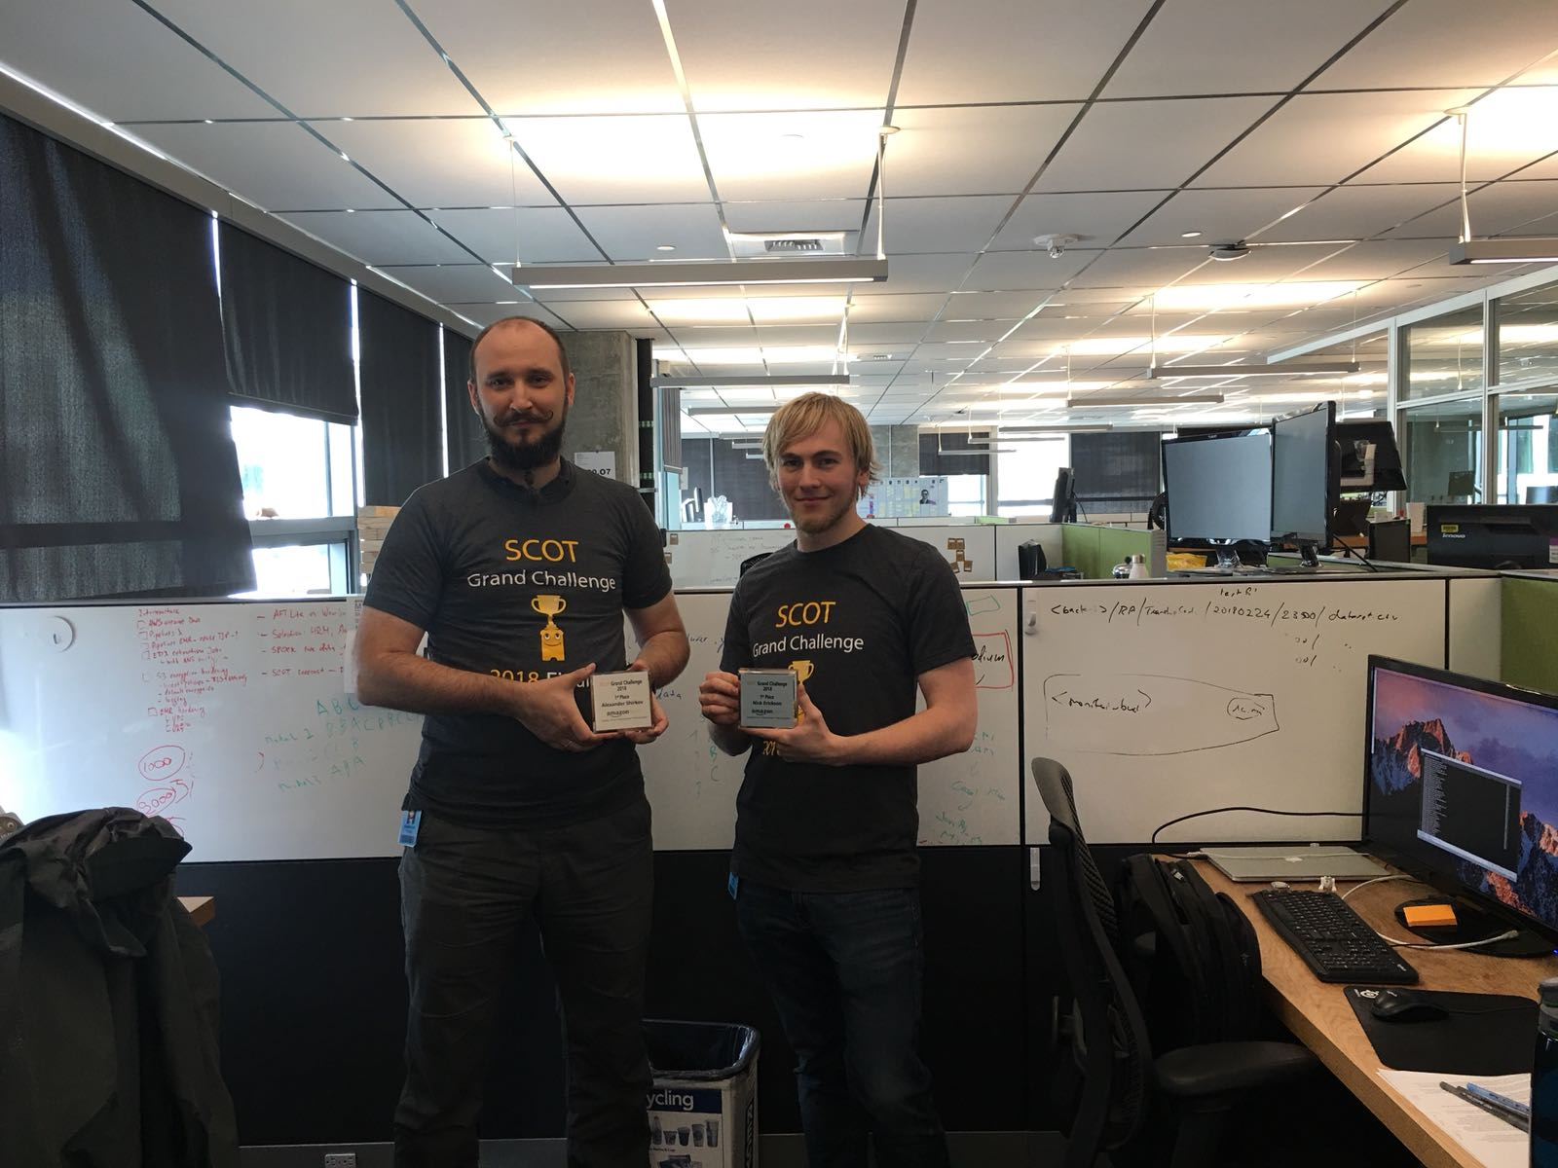
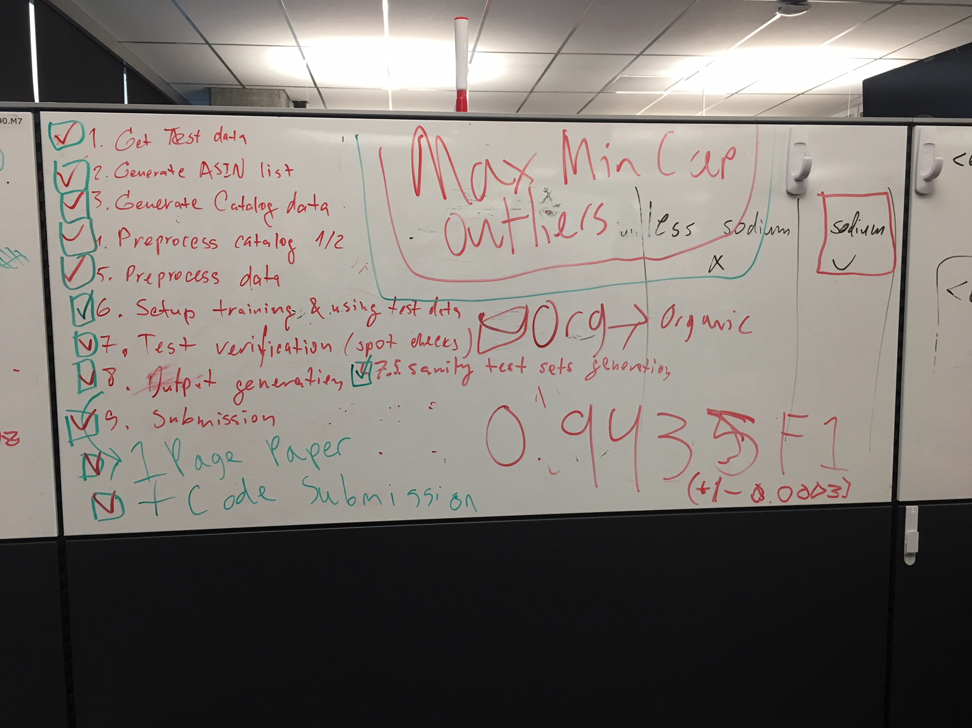

Origins of AutoGluon
SCOT Grand Challenge 2018
Alex Shirkov & Nick Erickson

Slide 9
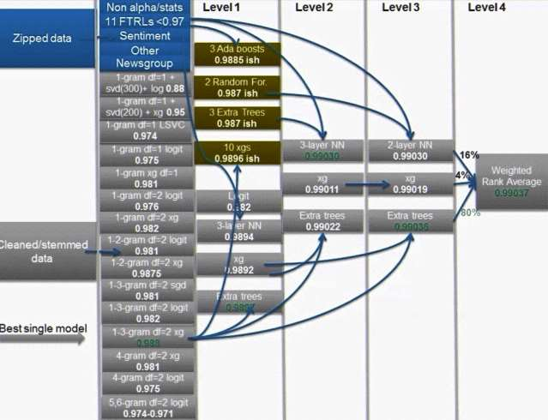
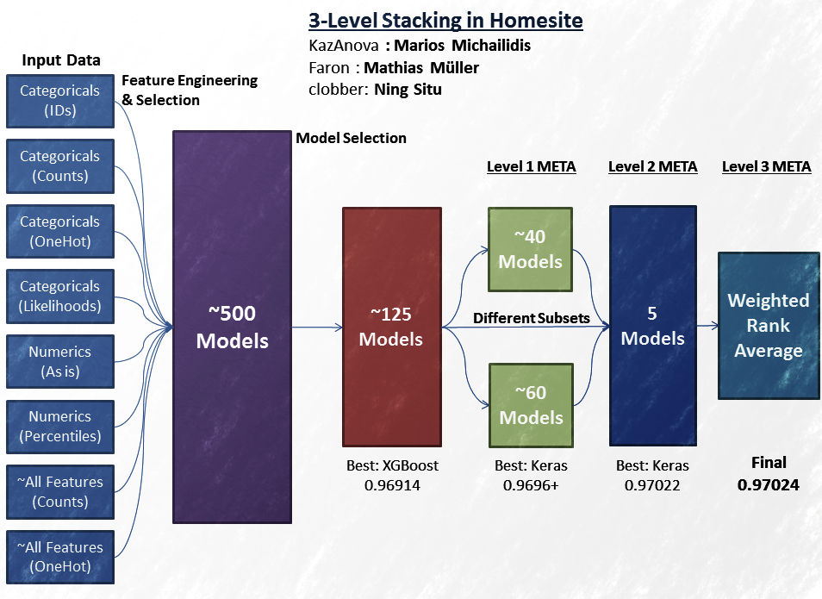
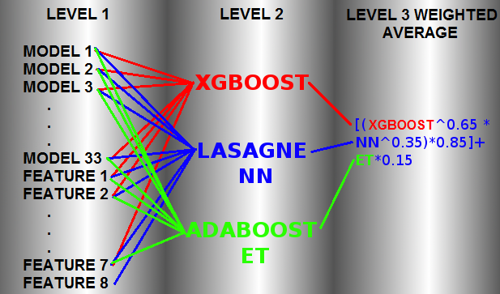
Monsters Dominate ML Competitions

Slide 10
AutoGluon Tames the Monsters
Take the core principals that allow monsters to succeed and generalize them with a maintainable and extensible architecture.
Abstract the details away from the user, giving them the benefits without complexity overhead.
Provide strong defaults that work well across a wide range of problems.

Slide 11
Accurate ML in 3 lines of code
from autogluon.tabular import TabularPredictor
predictor = TabularPredictor(label="class")
predictor.fit("train.csv", time_limit=600, presets="best")
predictions = predictor.predict("test.csv")

Slide 12
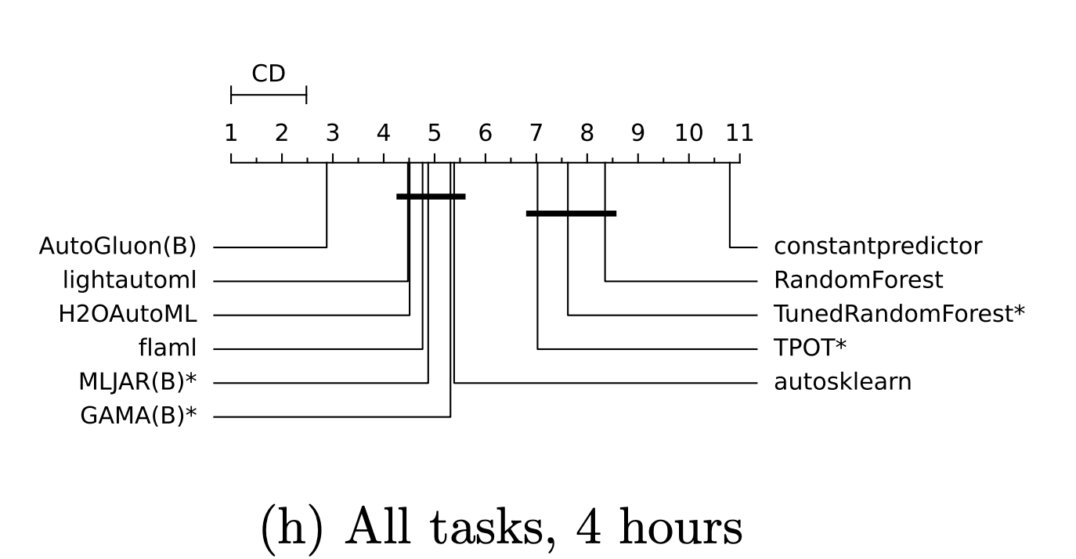
AutoGluon and AutoML
Prior work: AutoML == Model + Hyperparameter Selection (CASH)
AutoGluon: Rely on strategies that win prediction contests
Strong and diverse model portfolio
Multi-Layer stack ensembling
Boatloads of tricks and optimizations
State-of-the-art on the OpenML AutoMLBenchmark 2024
Reference: Gijsbers, Pieter et al. “AMLB: an AutoML Benchmark.” JMLR, 2024.

Slide 13








AutoGluon Model Variety

Slide 14
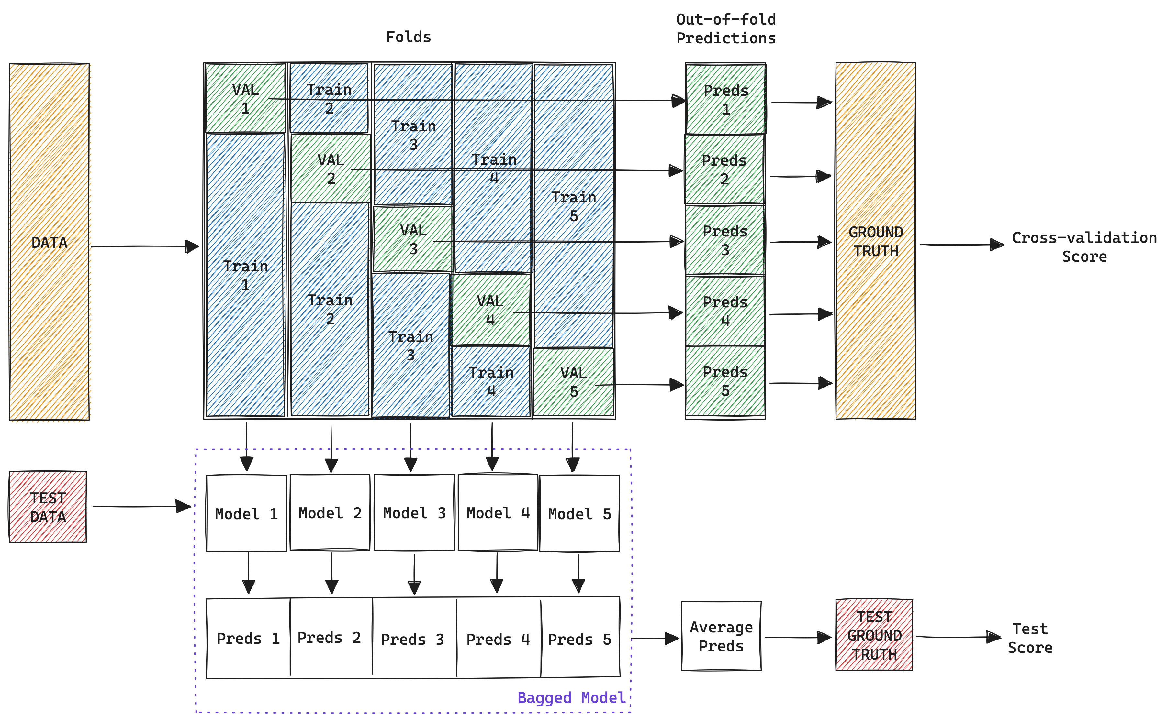
Model Bagging

Slide 15
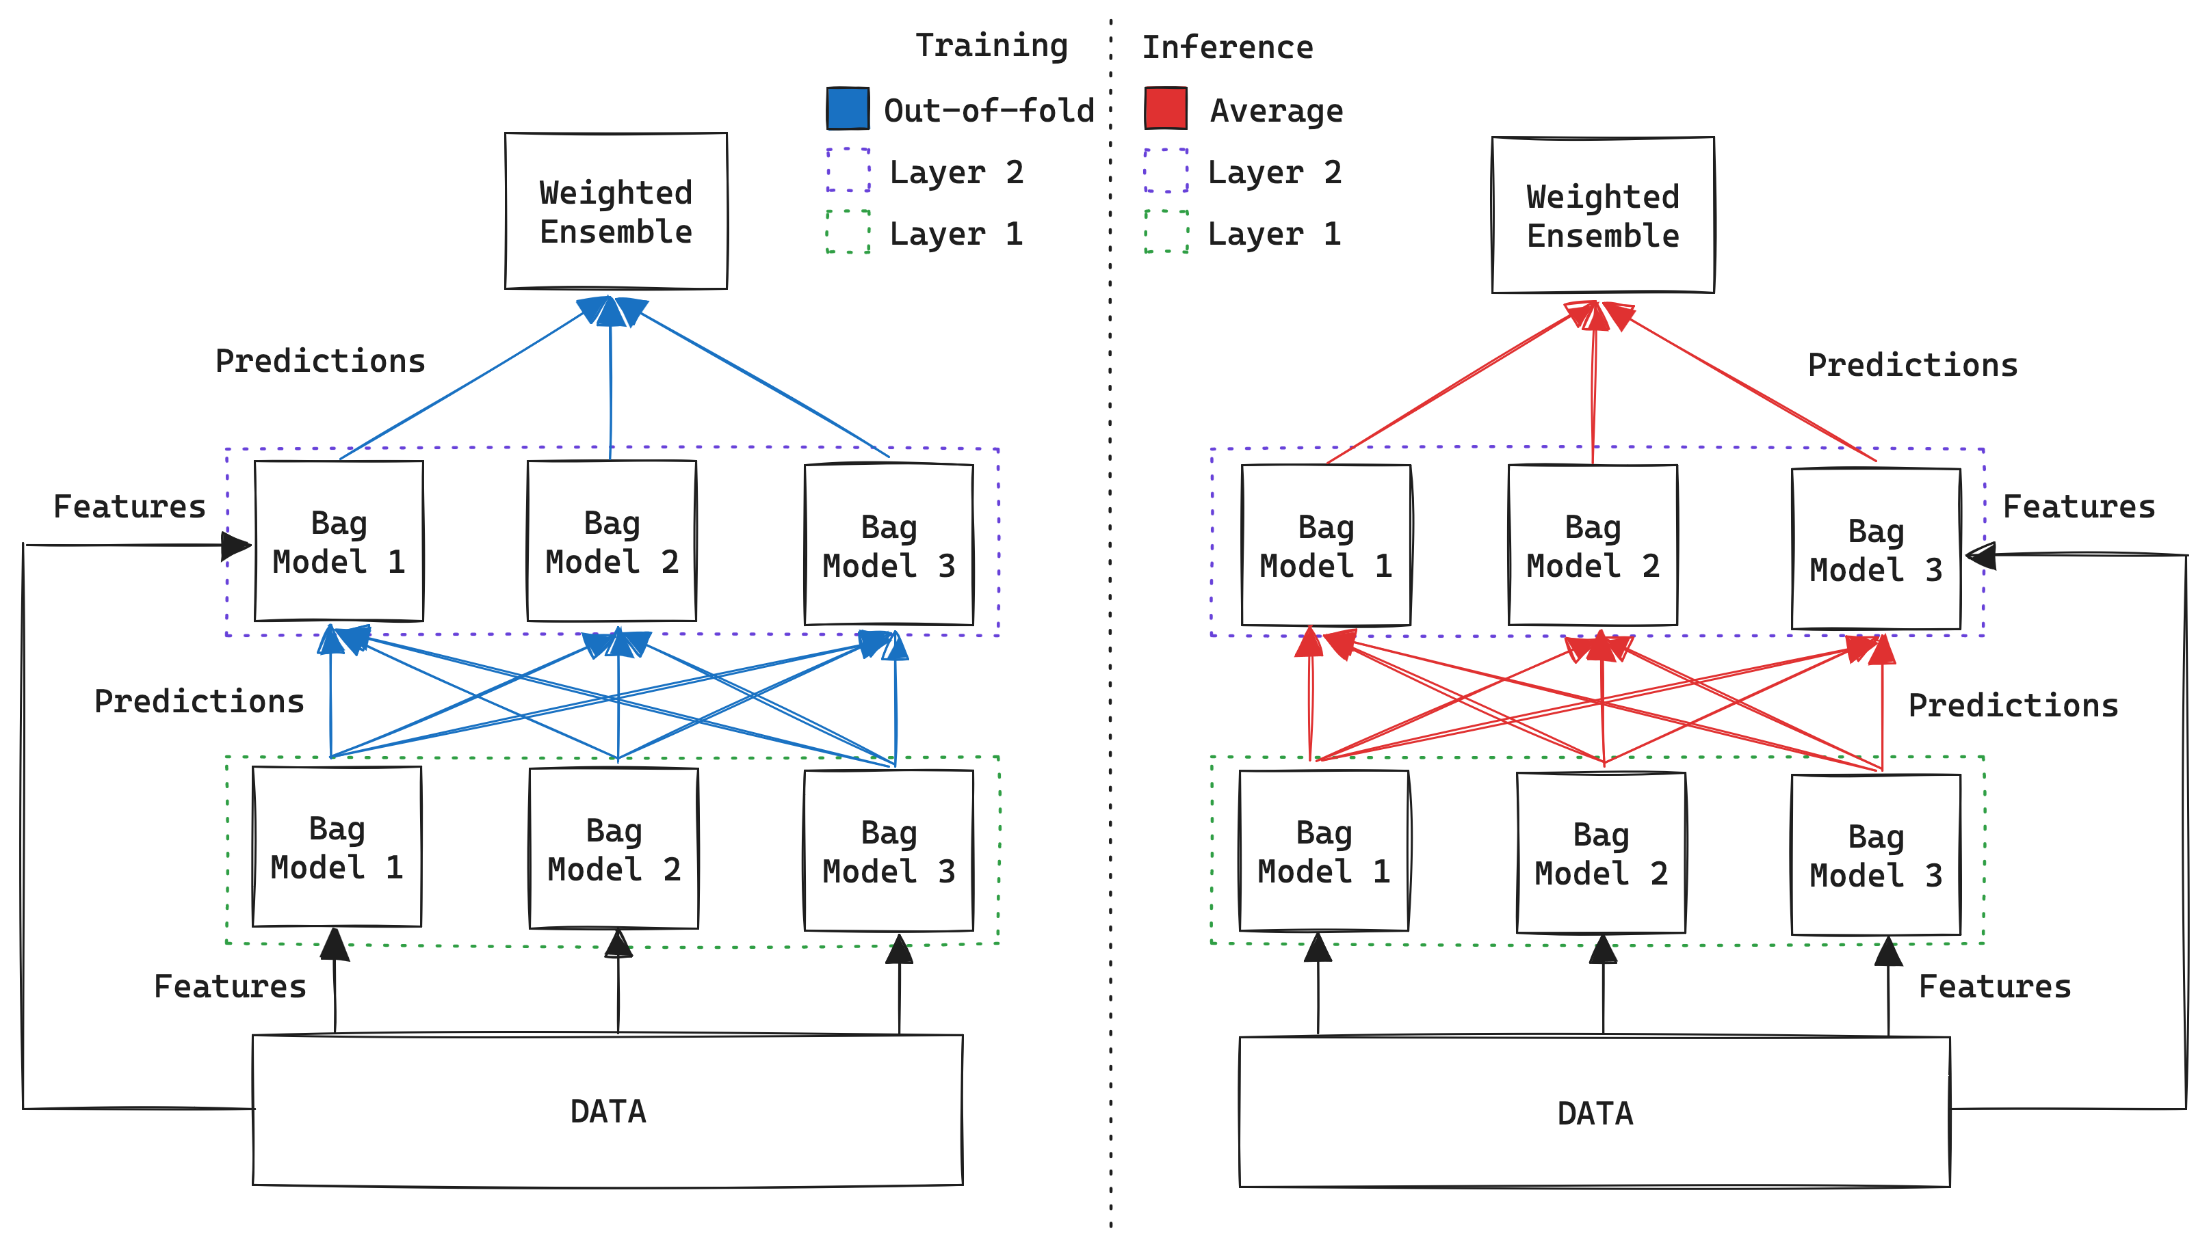
Multi-Layer Stack Ensembling

Slide 16
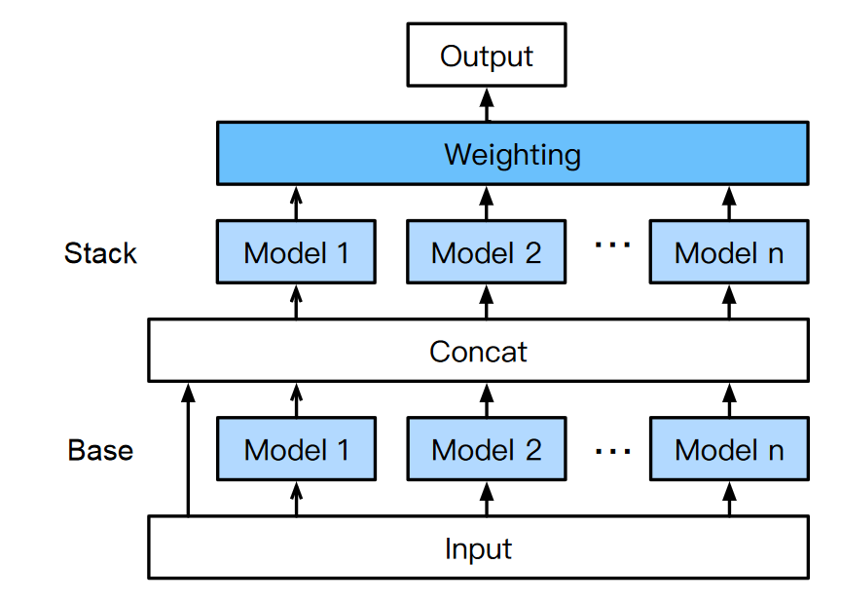
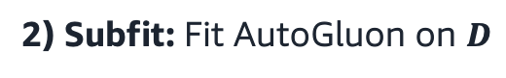
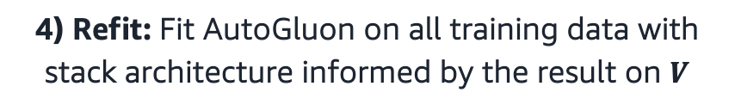

Dynamic Stacking: Avoiding stacking’s failure cases
1) Split training data to obtain new training data $D$ and a holdout set $V$
2) Subfit: Fit AutoGluon on $D$
3) Determine whether Stacked Overfitting occurred using $V$
$$V$$
validate on
Stacked overfitting, yes/no?
4) Refit: Fit AutoGluon on all training data with stack architecture informed by the result on $V$

Slide 17
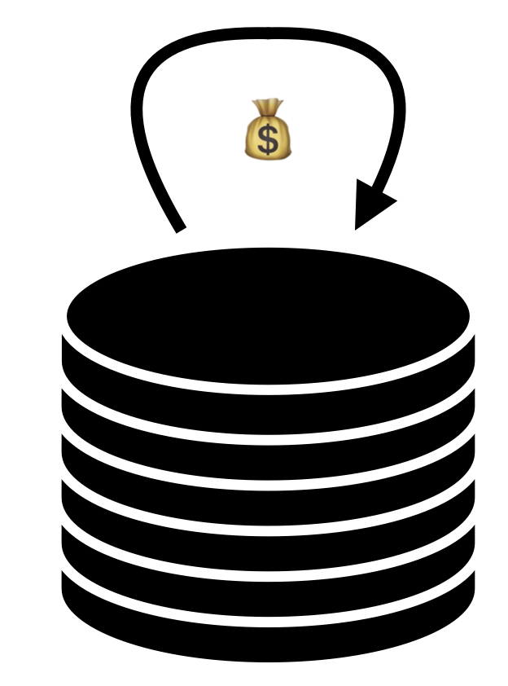
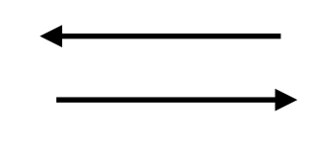
TabRepo: Precomputed results for Tabular ML
Save validation & test set predictions for
1530 random bagged model configurations
11 model families (CatBoost, MLP, TabPFN, …)
200 OpenML datasets, 3 folds each (600 tasks)
Total of 7.75 million fitted models (330 GB)
train MLP with learning rate 1e-3 and 192nd architecture?
{
“accuracy”: 0.92,
“time_train_s”: 723,
“time_infer_s”: 1.2,
“preds_val”: …,
“preds_test”: ….,
}
Reference: Salinas and Erickson. “TabRepo: A Large Scale Repository of Tabular Model Evaluations and its AutoML Applications” AutoML, 2024.

Slide 18
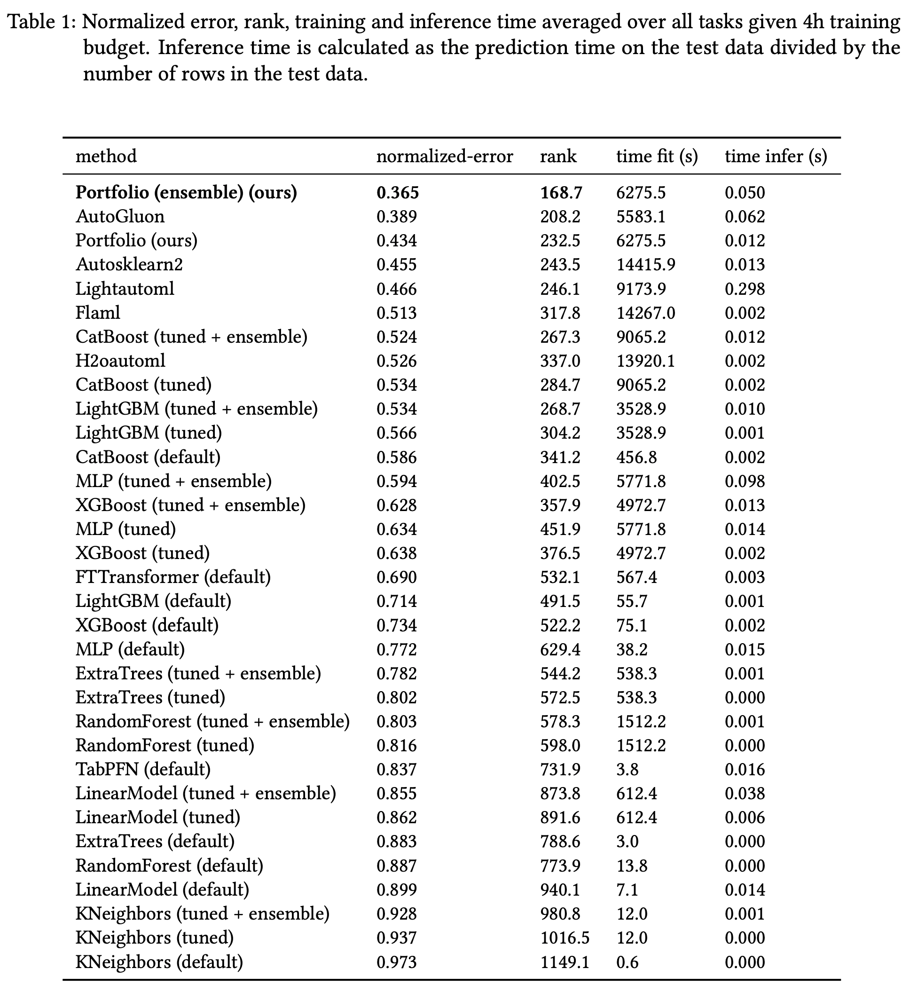
TabRepo: Offline Ensemble Simulation
We can use precomputed results to find good portfolios
Starting from an empty list, simply select the best model to add to the existing portfolio that achieves the best average test score on the training datasets, and repeat N times for a portfolio of size N
Evaluate via 200-fold cross-validation
Simulate days of experiments in seconds (>10000x speedup)
Portfolio outperforms AutoGluon…
Adopt Portfolio in AutoGluon -> New SOTA!
Reference: Salinas and Erickson. “TabRepo: A Large Scale Repository of Tabular Model Evaluations and its AutoML Applications” AutoML, 2024.

Slide 19
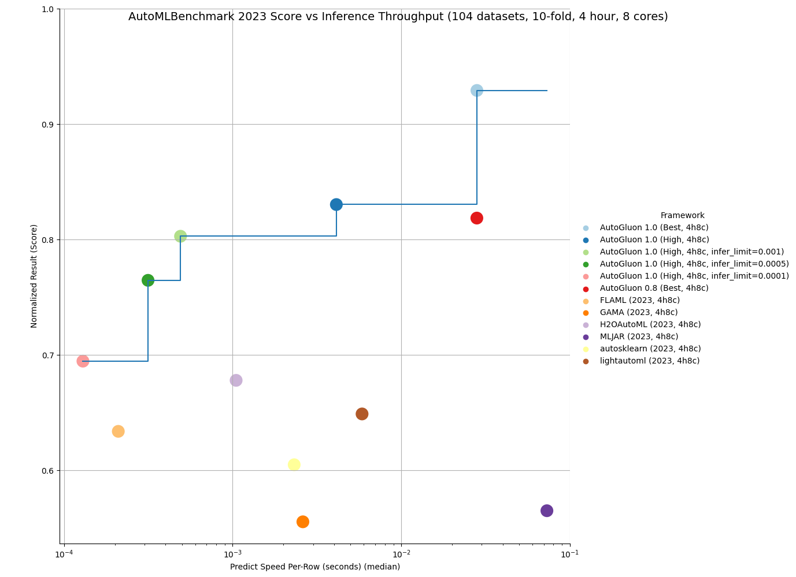
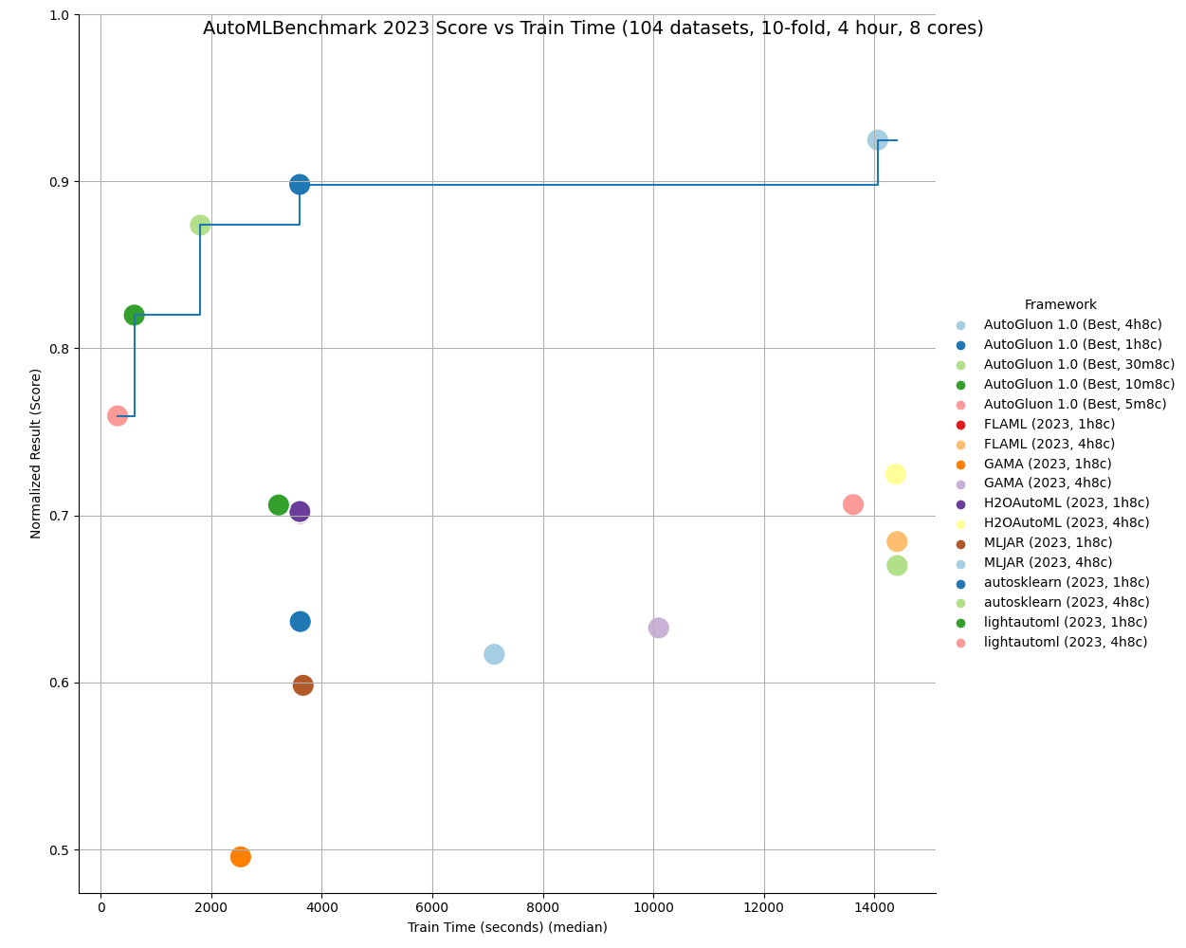
AutoML Benchmark 2024 Accuracy, Inference, Train Time Pareto Frontiers
AutoGluon 1.0
AutoGluon 1.0
AutoGluon 0.8

Slide 20
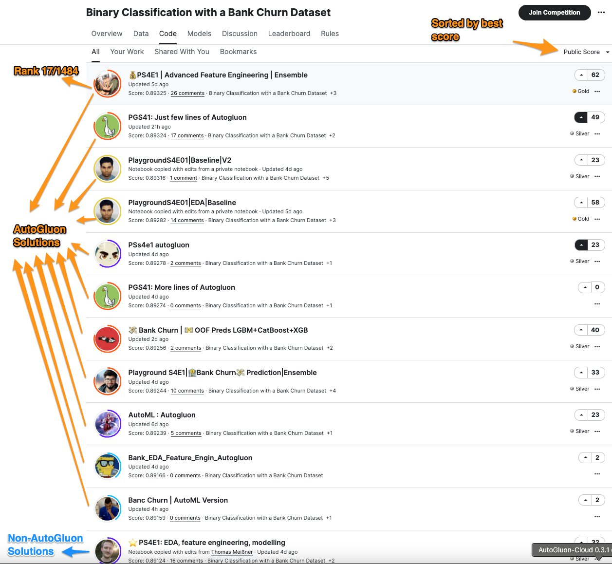
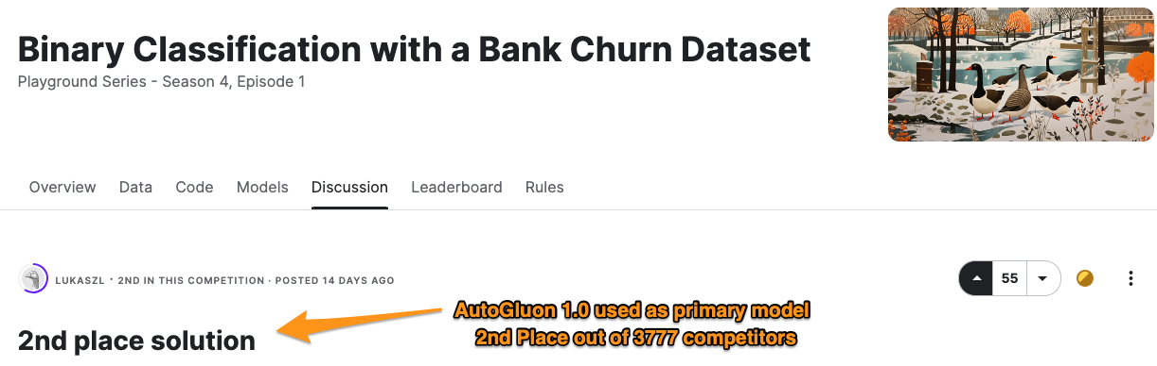
AutoGluon 1.0 on Kaggle: Playground Season 4 Episode 1

Slide 21
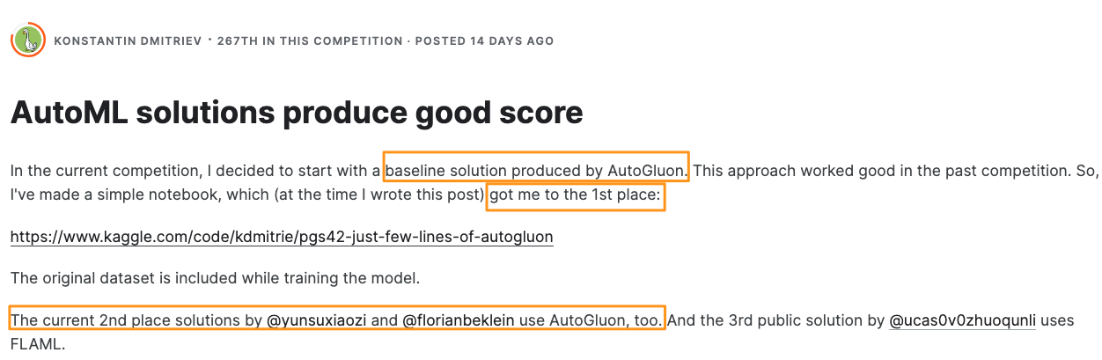
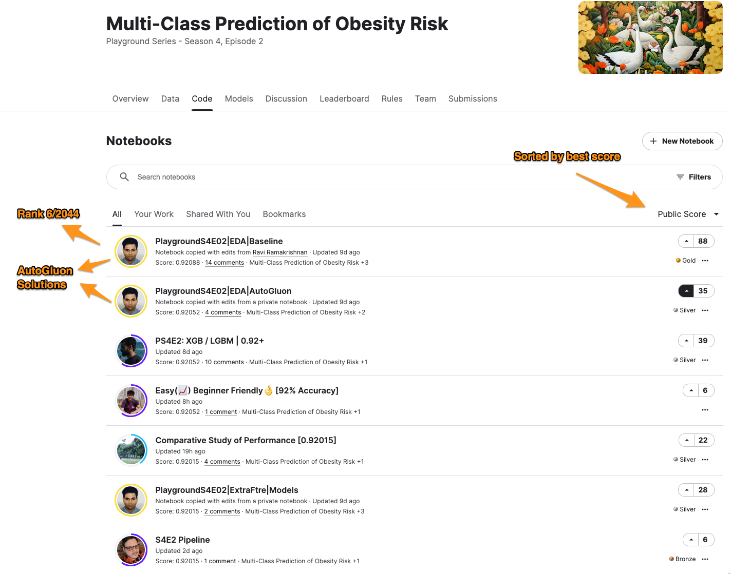
AutoGluon 1.0 on Kaggle: Playground Season 4 Episode 2

Slide 22
Results in live ML competitions
Kaggle competition placement (2024, AutoGluon-Tabular)
In 2024, AutoGluon has become the ML community’s go-to tool for competitions
🥇
8 competitions
Finished in the top-3 in 16 out of 20 live Kaggle competitions in 2024 (Tabular)
🥈
5 competitions
Reached top-0.1% score on average; never outside of top-1%; >1500 avg competitors
🥉
3 competitions
Top
5
Top 1%
2 competitions
Equivalent to 19 Kaggle gold medals and 1 Kaggle silver medal
https://github.com/autogluon/autogluon/blob/master/AWESOME.md

Slide 23
AutoGluon 1.2 Major Features (Tabular)
New Tabular Foundation Model: TabPFNMix
Parallel model fitting for >2x training speedup on 32+ CPU core machines
Enhanced model calibration quality on small datasets
Callback support

Slide 24
AutoGluon 1.2: Introducing Tabular Foundation Models
New in AutoGluon 1.2: TabPFNMix
Transformer pretrained on pure synthetic tabular data
Based on TabPFN, with pretraining strategy inspired by TabForestPFN
Outperforms all public existing singular tabular models, including tuned CatBoost and TabForestPFN on datasets with <=10000 training samples
Supports both classification and regression
More details to come in an upcoming paper!

Slide 25
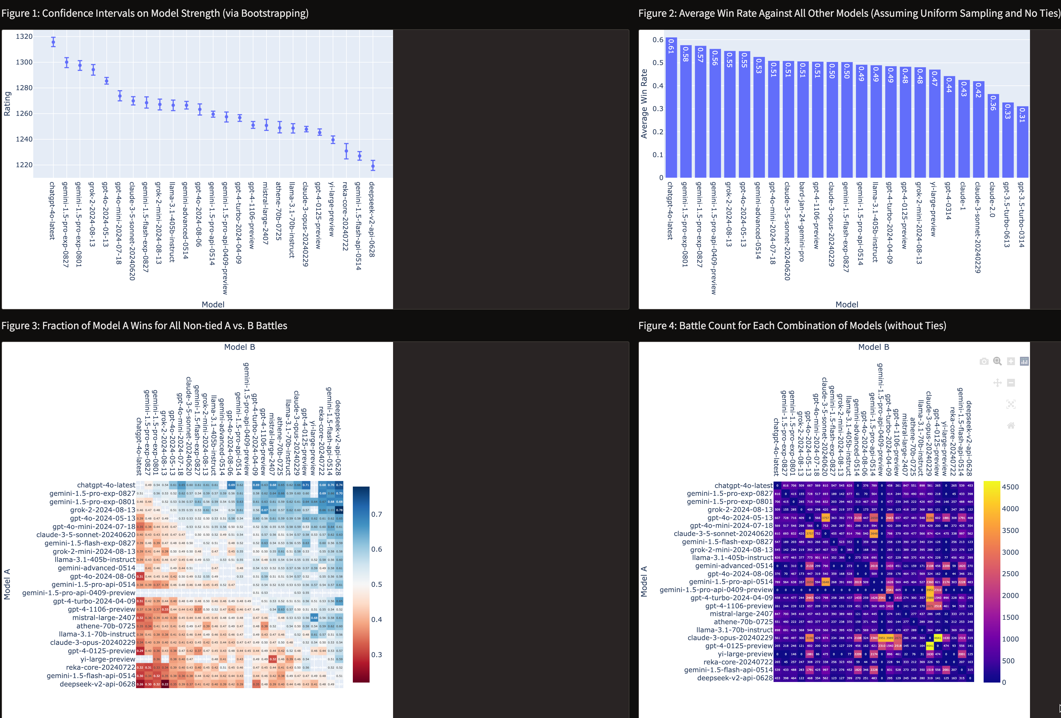
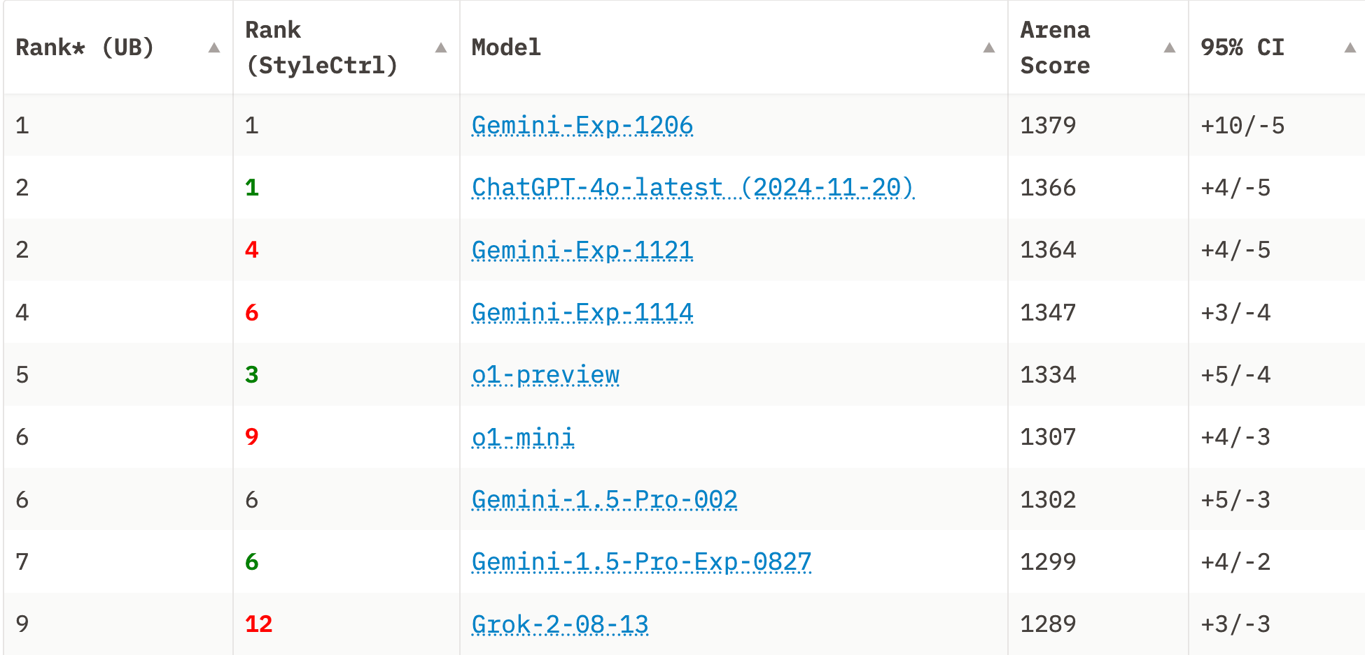
ChatBot Arena Has Very Nice Comparisons for LLMs!

Slide 26
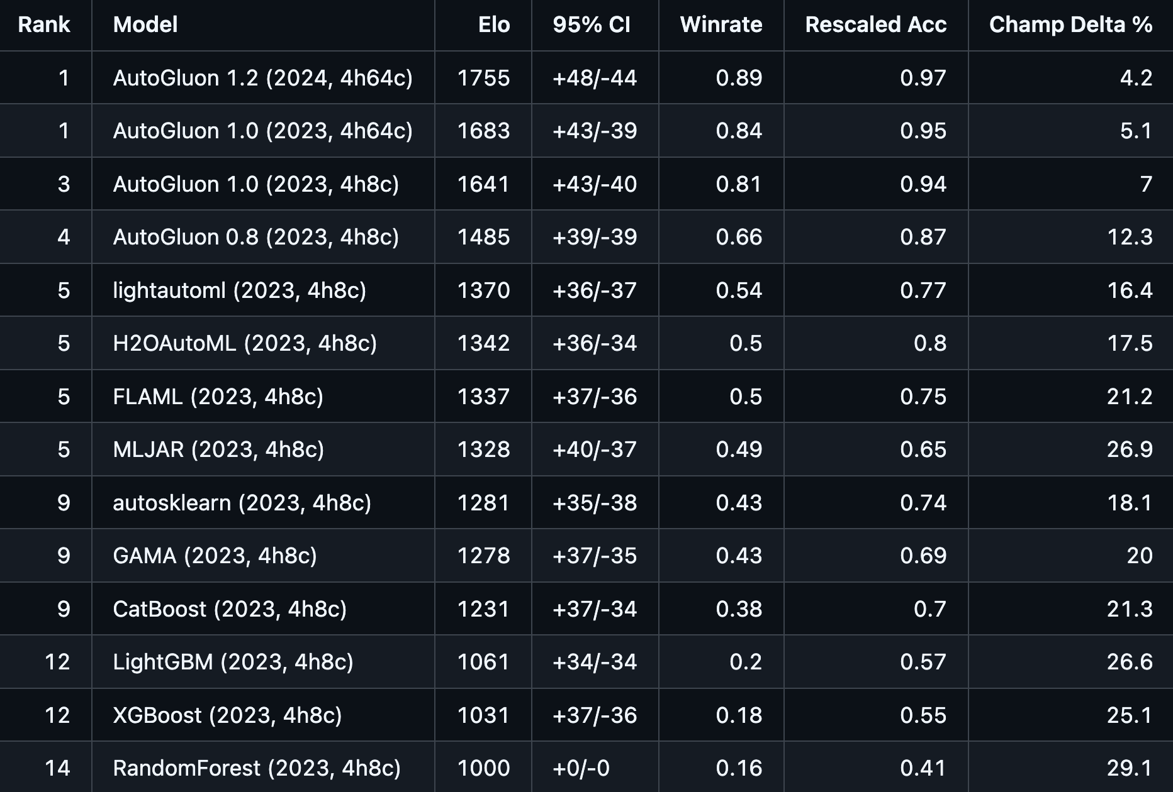
AutoMLBenchmark 2024

Slide 27
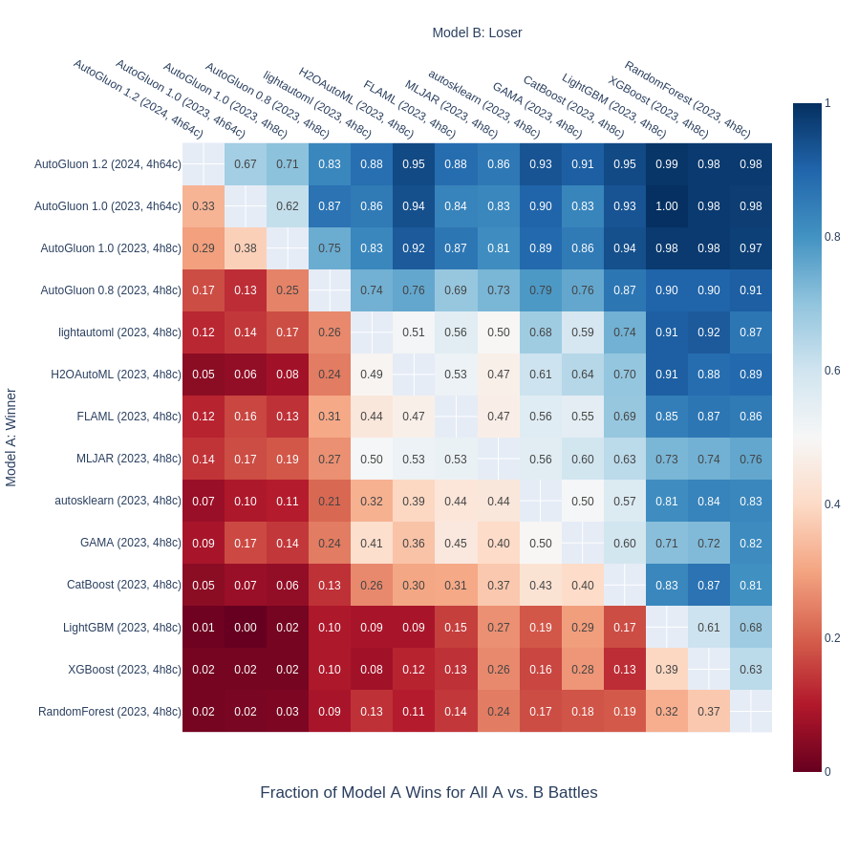
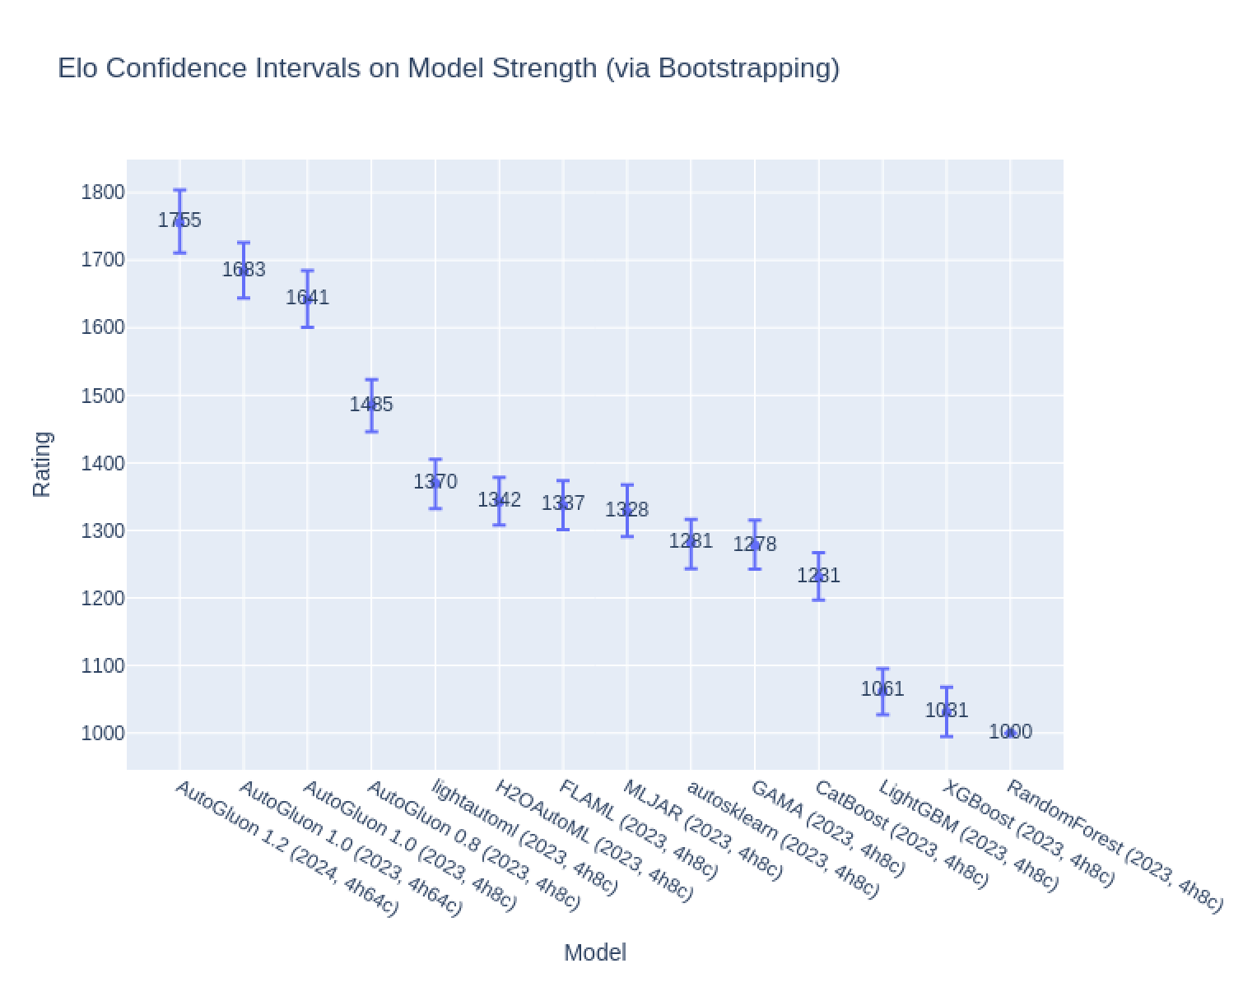
AutoMLBenchmark 2024 Pairwise Winrate

Slide 28
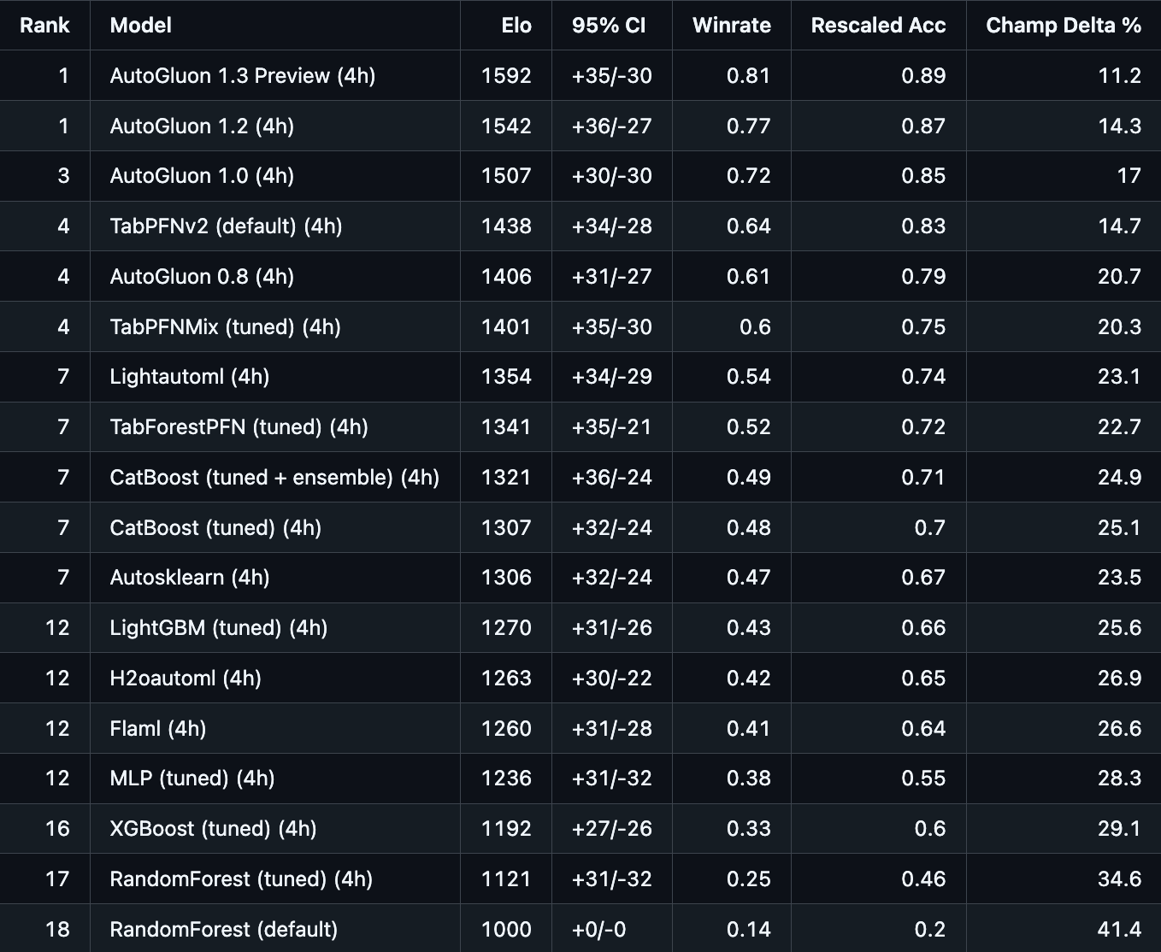
TabRepo 97 Classification Tasks, <=10000 training samples

Slide 29
Upcoming in 2025
Stronger and faster tabular foundation models
TabPFNv2
GPU Support
Better scaling to datasets with >10000 samples
TabRepo 2.0 Portfolio
Dynamic Portfolio Size
Incorporate more model families
Develop advanced methods for cross-validation to combat overfitting on small datasets
Much more, stay tuned!

Slide 30
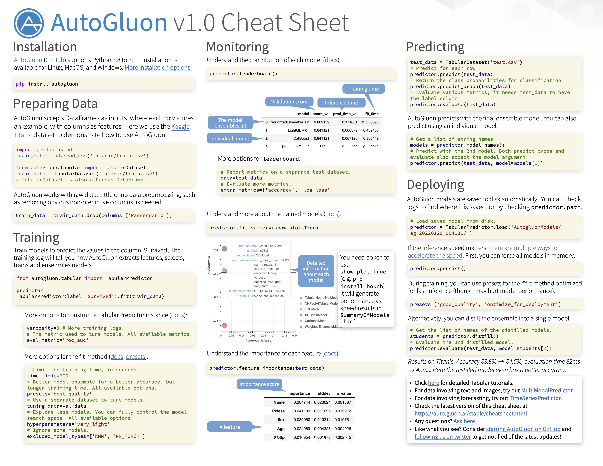

Slide 31
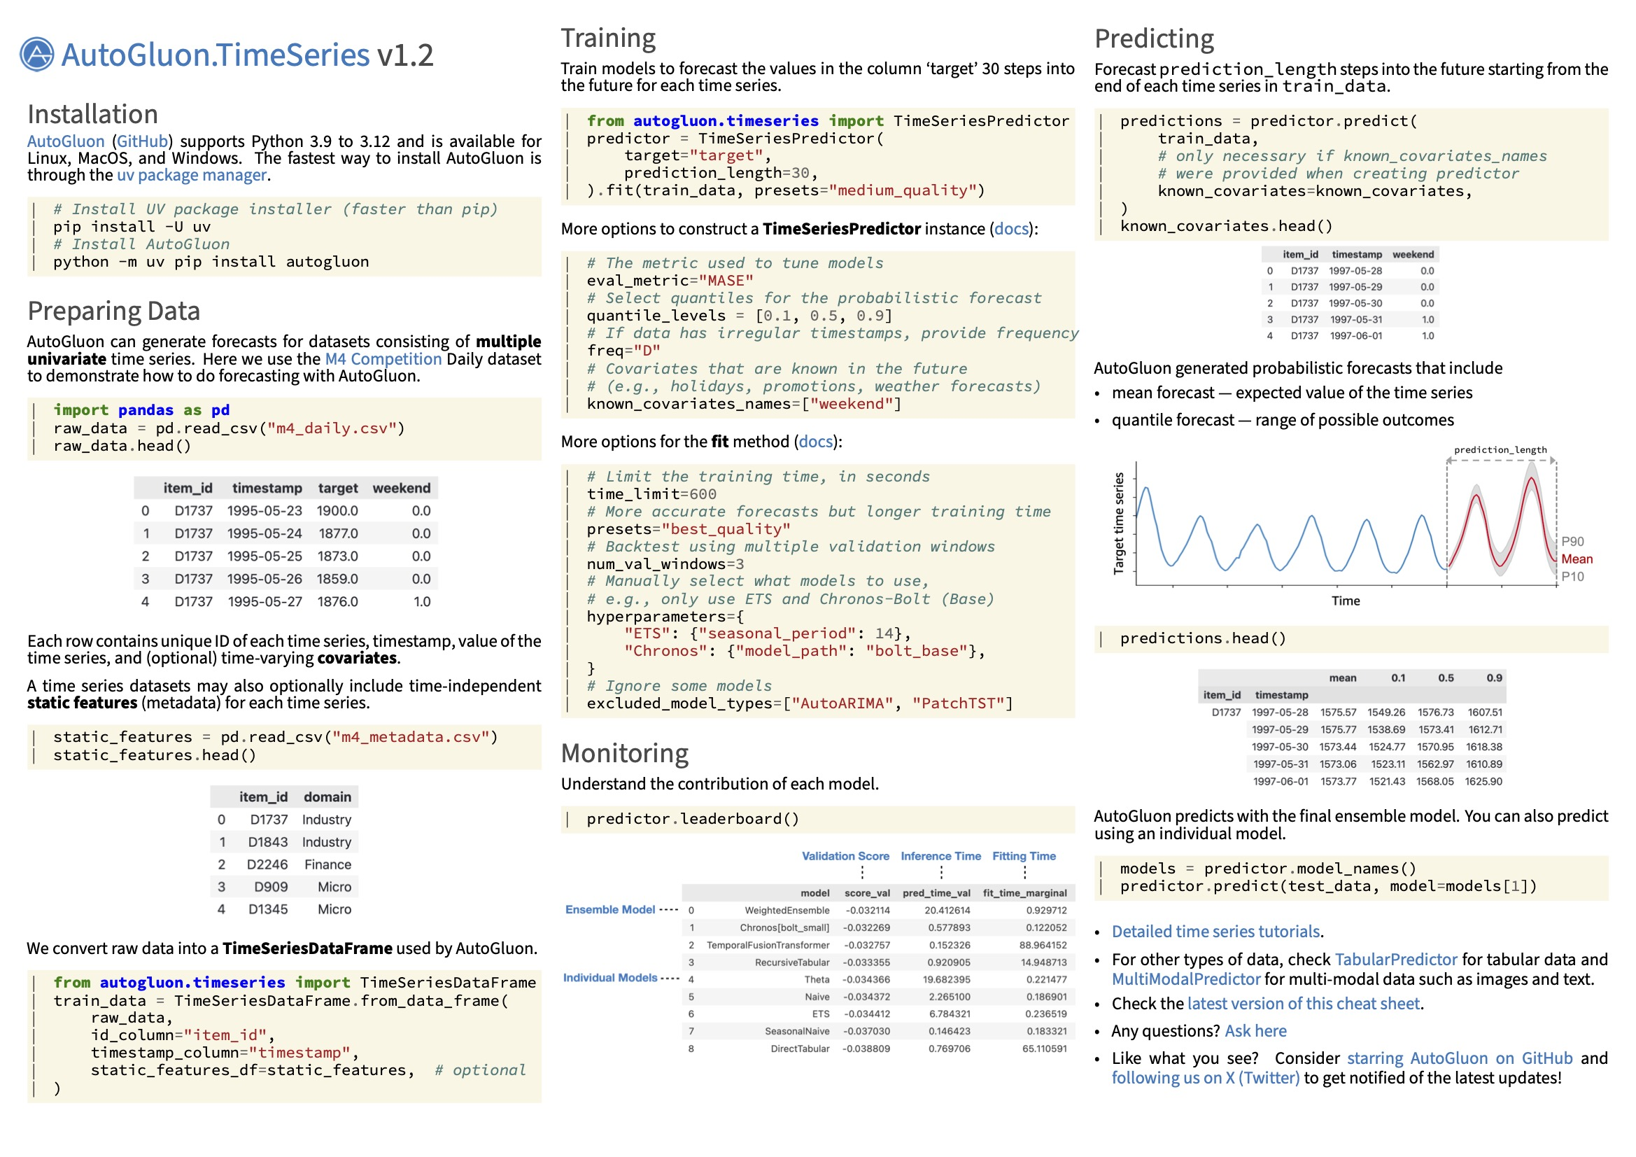

Slide 32
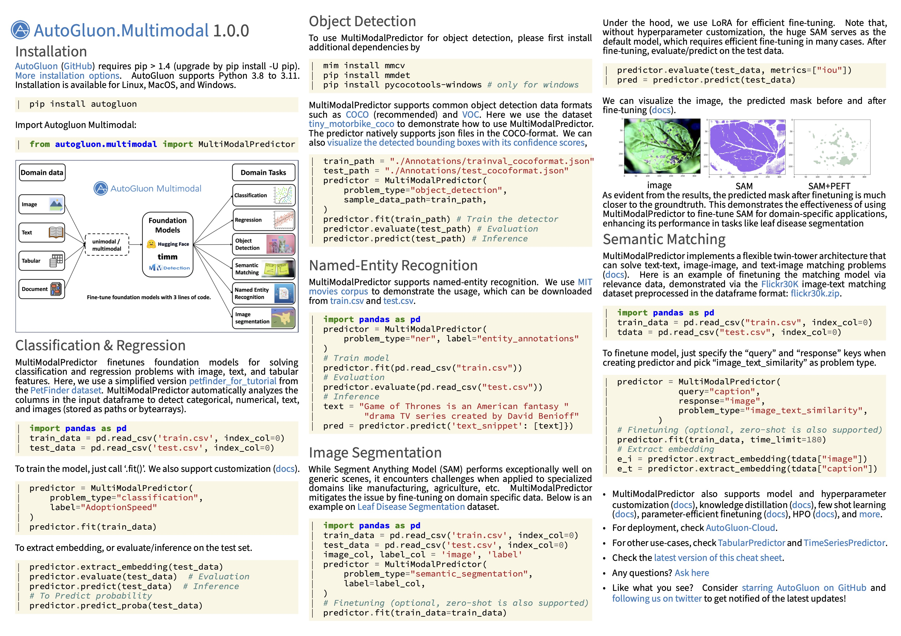

Slide 33


Thanks! Q&A
Get started with `pip install autogluon`
GitHub: github.com/autogluon/autogluon (Star us on GitHub if you like it ☺)
Open-source project. Welcome to contribute!
AutoGluon Community Discord: https://discord.gg/85hxEbyD
AutoGluon Website
AutoGluon Discord

